Slide 1
Computer Sharing Centre Introduction to WiFi and Tablets
5 March 2014

Slide 2
Introduction to WiFi and Tablets - Agenda and Introduction
Quick news update from the Computer Sharing Centre by Cherith Hateley
Background to today’s presentation by Cherith Hateley
What is ‘WiFi’ and how can I use it? by Carolyn Watkins
Introduction to the iPad, Tesco Hudl and Kindle fire
(including hands on experience) by John Apsey with Cherith and Carolyn supporting
Introduction to the tablet lesson trial by Cherith Hateley
Summary by Cherith Hateley

Slide 3
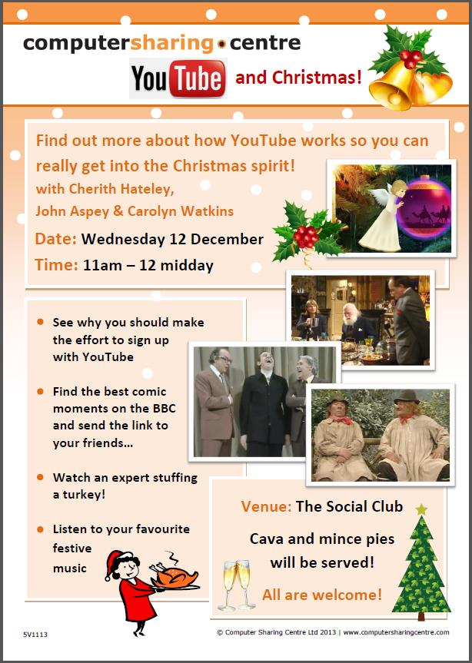
Latest news from the Computer Sharing Centre
Computer Sharing Centre News!
Christmas presentation
4 December “YouTube”
Attended by 29 of us
We watched the two Ronnies & Leonard Rossiter
dressed as girls singing to WW2 soldiers
and learnt about YouTube!
In 2014 presentations will be in Morden Hall
Environment: Cleanliness, computer reliability, broadband connection (speed and reliability)
All clean and working well, broadband fast, new wireless printer to be installed in March (great for tablets)

Slide 4
2013 Annual Report on the Computer Sharing Centre
Lesson attendance and subjects covered
426 lessons available, 413 attended (97%).
Lots of work on Memory Sticks, Microsoft Word, How to Copy and Paste, Digital camera/Photography
New members in 2013: 15
Waiting list gives new residents priority so waiting time is over a year for a new term of lessons
Monday morning surgery very popular and helpful with 41 attended out of possible 43 available in 2013

Slide 5
Background to today’s presentation – some questions
How many of you have iPads/tablets?
Out of 30 residents 12 had iPads and 4 had Android tablets
Were they a gift or did you buy it for yourself?
Only one (from the nursing home) was given the iPad
What do you use them for?
Looking things up, email, tv/entertainment
What do you think of them?
They thought they were brilliant
Are you confident that you are using them well?
A chorus of ‘NO!’
Comparison http://www.youtube.com/watch?v=T0eaeF6fZ0Y

Slide 6
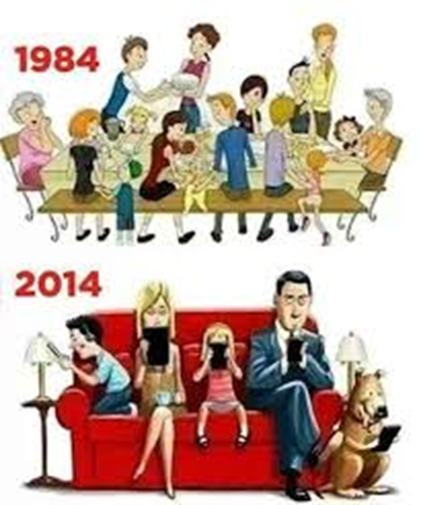
Background to today’s presentation
How did we get here? What is the future?
25 Years
January 18th 2014 was the 25th anniversary of the internet
Too much choice? Are things too complicated now?
Standard tv with Freeview offers over 50 TV channels, 10 HD channels, and 24 radio stations. Sky tv has 10,500,000 customers. Internet tv is rolling out (13% by end of 2014)
Today most people have smart phones
iPads have 590,741 Apps (or small applications to choose from) with Hudls (android device) having 1,132,053
The UK Government expects us to
access services ‘digitally’

Slide 7
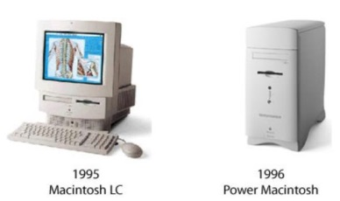
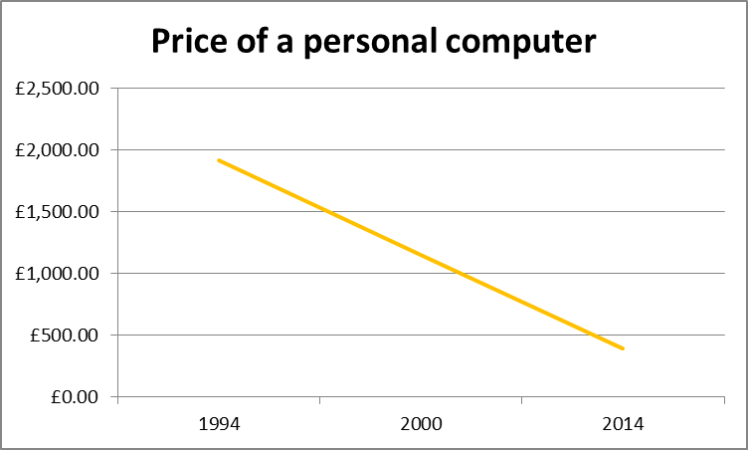
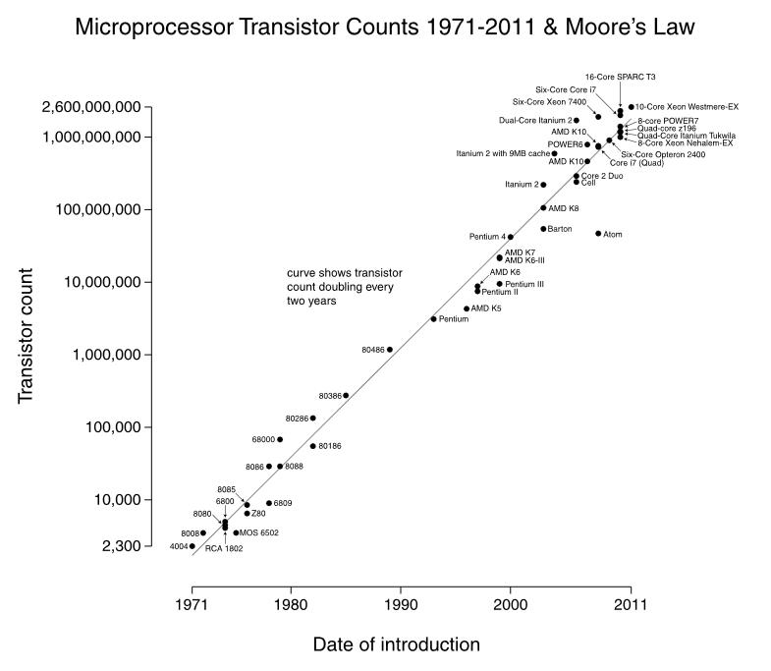
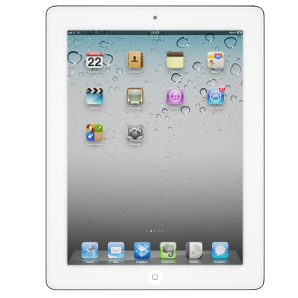
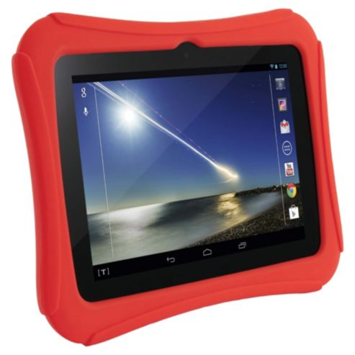
Background to today’s presentation
How did we get here? What is the future?
In 1994 a personal computer cost £4,000
In 2014 it costs £300-400 and is 2,600 times more powerful in terms of transistor counts!
The Hudl has a high definition screen, two cameras, a microphone and speakers – for £119!

Slide 8
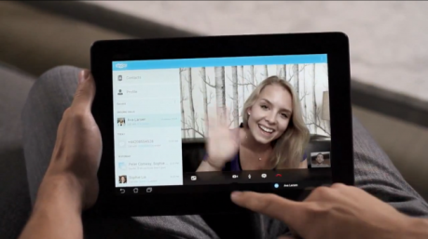
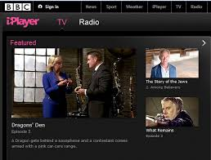
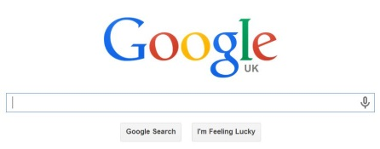
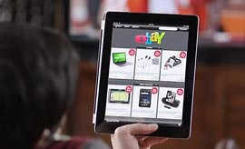
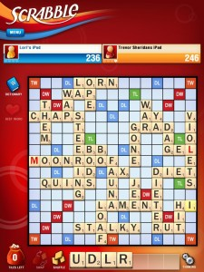
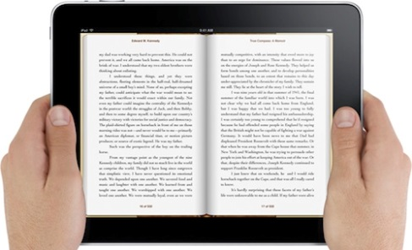
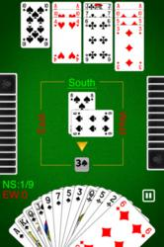
Background to today’s presentation
Here are a few of the things you can do on a tablet!
Read a book
Watch or listen to a programme with BBCiPlayer
Listen to an audio book
Catch up on the latest news (and sport!)
Check your email
Dictate an email using the microphone!
Look something up (research)
Skype a friend who is far away
Listen to music
Play scrabble or any other game
Oh yes! And people buy things with them ☺

Slide 9
Background to today’s presentation
Learning how to do what you want to do on a tablet computer is not so easy
You need to know the following things:
How to charge it, turn it on and off or to ‘sleep’
How to use the touch screen confidently
How to open and close ‘apps’
How to use the individual apps for books, music etc. (and how to buy content for your tablet)
How to manage the wifi connection, volume, brightness and data storage space
How to update it to the latest software
Plus a whole lot more!

Slide 10
Background to today’s presentation
How did we get here? What is the future?
1994 a computer in came with manuals and CD’s for repair.
Now in 2014 computers have no manuals and no instructions, so how do people learn how to use them?
If an Instructor could be paid to come to your home and teach you the skills you need for your iPad/tablets. Would you consider it? (a resounding yes)
Children learn enthusiastically by sharing skills, by showing each other at school and through play.
“There is nothing so exhausting as trying to find out how to do something new on your own.”
James Kessler
Perhaps the best way to predict the future is to invent it!
Adults often give up and new iPads gather dust on the shelf.
This is from a German comedy programme where the daughter has given her father an iPad as a present and finds him making use of it!
www.youtube.com/watch?v=R6WuHzE-1fk

Slide 11
Introduction to WiFi and Tablets
A short quiz to get us started
What is WiFi?
Wireless Internet, WiFi and WLAN all refer to a networking technology that uses radio frequency instead of physical wire to allow you to connect to the Internet when you’re in a wireless hotspot location.
Question 1 : How many free wifi ‘hotspots’ are there in the UK?
From Recombu: Tuesday 28 May 2013
There are over 4.5 million public Wi-Fi hotspots in the UK and Ireland, all waiting for you to get connected. Pretty much any major high street franchise has free Wi-Fi on offer. Right now, McDonalds, Starbucks, Pret a Manger, Costas and plenty of others, all will give you free internet while you eat.

Slide 12
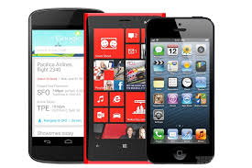
Introduction to WiFi and Tablets
What is a smartphone?
1,000,000,000
Question 2 : How many smartphones were sold in the world in 2013?
From The Guardian: Wednesday 29 January 2014
The smartphone market passed a key milestone in 2013, with
1bn devices sold during the year, according to the research
company IDC - and other research companies gave almost identical figures.
1,820,000,000
Question 3 : What was the total number of mobile phones sold in total in 2013?
The total mobile phone market was 1.82bn handsets in 2013, up just 4.8% from 1.74bn in 2012, said IDC. Smartphones made up 55% of
all mobile phone sales in the year.

Slide 13
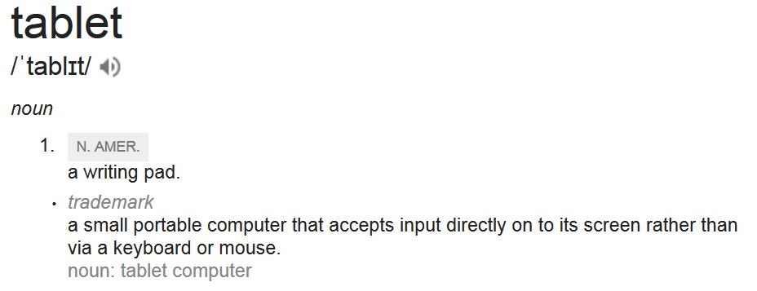
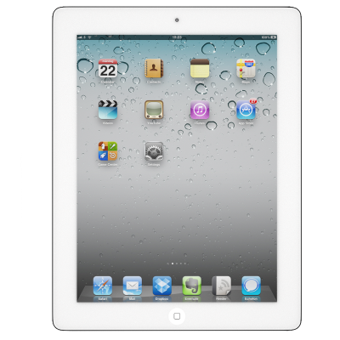
Introduction to WiFi and Tablets
What is a tablet computer?
170,000,000
Question 4 : How many iPads do you think have been sold since 2010?
These are the cumulative figures from Apples quarterly financial reports
Oct. 22, 2013 - 170 million Sept. 21, 2012 - 84 million April 2012 - 67 million January 2012 - 50 million

Slide 14
Quiz results... How did you do? A bit of philosophy
iPads, Hudls and Kindle Fires are amazing devices that can do very good things.
They do not come with any instructions as we are expected to figure it out as we go along. Sadly, this means two things. Firstly that they are used primarily for games and watching tv, and secondly as soon as something doesn’t work the way we want, they get left on the shelf to gather dust.
So what is the answer?
Affordable and effective one-to-one lessons with trained Instructors that are backed up with summaries sent to you via email.
Tablet tuition trial (no charge) starting in April 2014
6 people are needed who would like one-to-one lessons on iPads, Hudls/Android tablet) or Kindle Fires.
They will receive one 30 minute, 45 minute or
60 minute lesson once a week for six weeks.
We hope to support Cullum Welch Court residents once they have WiFi.
This is what can happen if you are given an iPad without any help with knowing how to use it
www.youtube.com/watch?v=R6WuHzE-1fk

Slide 15
Introduction to WiFi and tablets
What is WiFi? by Carolyn Watkins
Wireless Internet, WiFi and WLAN all refer to a networking technology that uses radio frequency instead of physical wire to allow you to connect to the Internet when you’re in a wireless hotspot location.

Slide 16
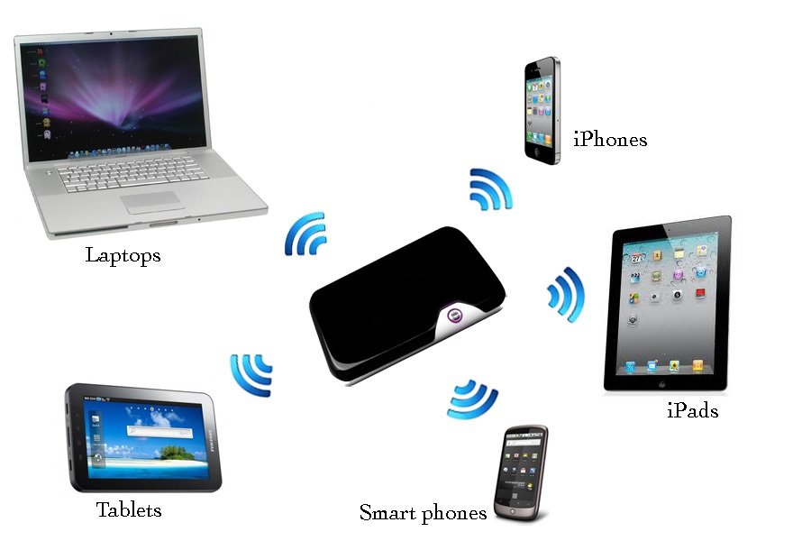
What is WiFi?
What is WiFi? a networking technology that uses radio frequency instead of physical wire

Slide 17
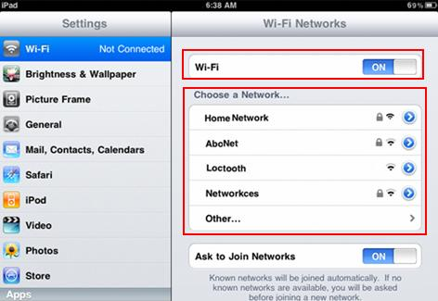
How do I tell my iPad to connect to a WiFi hotspot?
Step 1- Turn on your iPad and gently tap on the ‘Settings’ icon.
Step 2- Tap on the ‘Wi-Fi’ category to navigate yourself to the ‘Wi-Fi networks’ section. The iPad will now look for local wireless networks displaying their names.

Slide 18
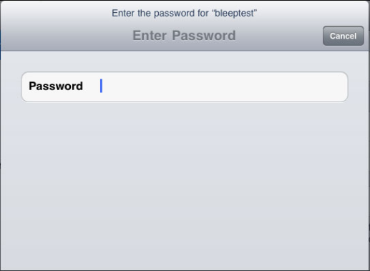
How do I tell my iPad to connect to a WiFi hotspot?
Step 3 - Look for the network that you would like to connect to and tap on it.
If the network has a lock next to its name you will need to enter the password to establish the connection.
Step 4 - Enter the password using the touch keyboard that will appear.
The good news is that the tablet/iPad will remember the password and automatically connect if you return to this WiFi hotspot!

Slide 19
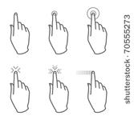
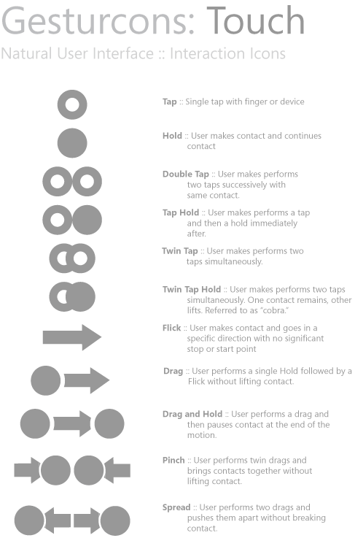
Introduction to the iPad, Tesco Hudl and Kindle fire
All tablets are touch screen computers that use small applications or Apps
Introduction to iPads: http://www.youtube.com/watch?v=JMht9_F3580

Slide 20
Introduction to the iPad, Tesco Hudl and Kindle fire
Three tables, visit the table and see how to use the tablet! 10 minutes
iPad with John Apsey
Hudl with Carolyn Watkins
Kindle Fire with Cherith Hateley

Slide 21
Summary
Tablet tuition trial
If you are interested in taking part, please complete the form.
Thank you!
Perhaps the best way to predict the future is to invent it

Slide 22
Summary
Background to today’s presentation
Computers (Tablets or laptops) do not come with instruction manuals and it is not seen as important to know how to use them, so many people give up or just play games on them. A course of 6 lessons with a trained ‘Computer Driving Instructor’ would develop skills and confidence.
What is ‘WiFi’ and how can I use it? by Carolyn Watkins
It is a networking technology that uses radio frequency instead of physical wire to allow you to connect to the Internet when you’re in a wireless hotspot location. Go to ‘Settings’ and enter the password (only once!).
Introduction to the iPad, Tesco Hudl and Kindle fire
Hands on practice with using the touch screen.
Introduction to the tablet lesson trial by Cherith Hateley

